Slide 1
Quantum Computing- Harnessing Superposition and Entanglement
Quantum Computers can do calculations in seconds, that would take binary computers upwards of 30,000 years.
Bits are 0,1
Quantum Bits are 0,1,or both 0 and 1 simultaneously
Quantum Computers are extremely Delicate because the particles quickly decohere when observed or are disturbed.
Understanding how entanglement works and how to manipulate entanglement will allow us to control quantum states is a more effective manner.
Please feel free to read my code and my blog post

Slide 2
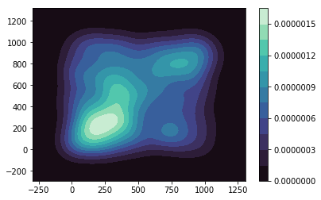
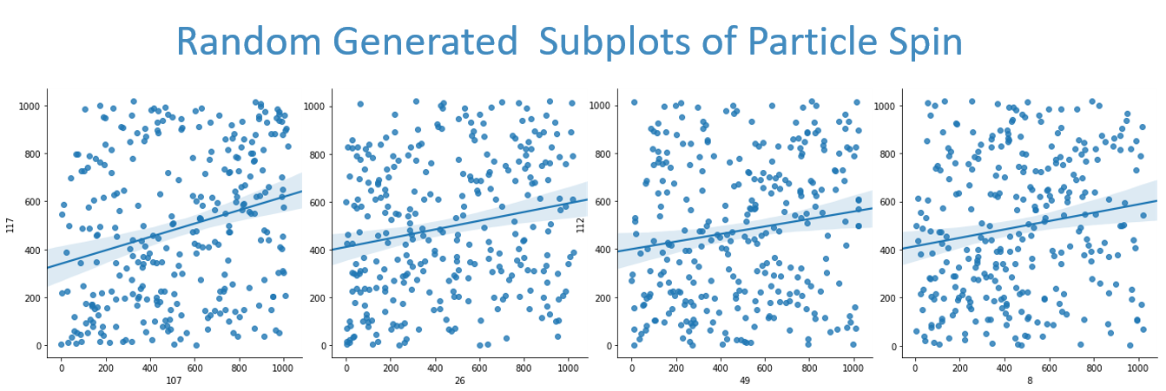
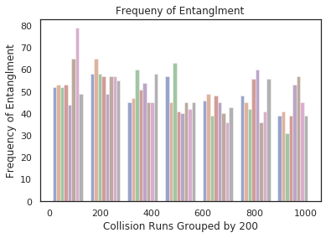
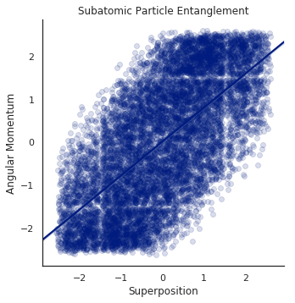
Visualizations that lend credibility to naturAL entanglement of subatomic particles
Density of Entanglment (All Runs)
Particle Angular Momentum x Sample Runs
Based on Subtype of Atomic particle and Collisions

Slide 3

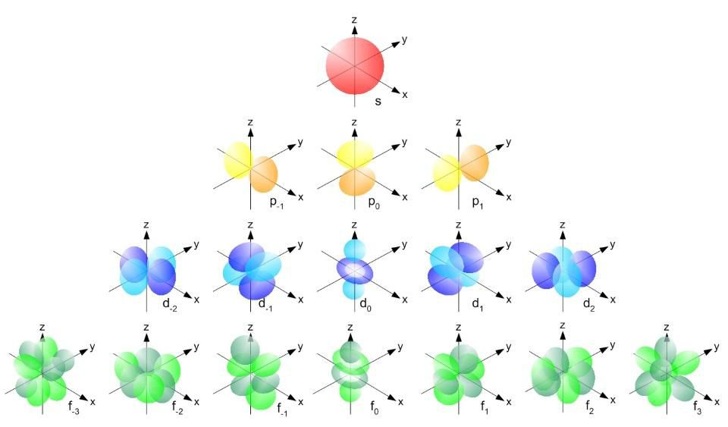
Links
https://colab.research.google.com/drive/1ylajmB3ByWG8W7nvRDYTtoTUKnmV0R-W
https://medium.com/@randomwalkjm/ghosts-in-the-machine-3d0115c065f6

